Slide 1

Unit 02.02.01 CS 5220: COMPUTER COMMUNICATIONS
TCP Reliable Stream and Flow Control
XIAOBO ZHOU, Ph.D.
Professor, Department of Computer Science

Slide 2
TCP ARQ Model
TCP reliable stream service
Connection-oriented
Error free, without duplication, in order of sequence
TCP uses Selective Repeat ARQ
Transfers byte stream without preserving boundaries

Slide 3
TCP Reliable Stream Service
TCP transfers byte stream in order, without errors or duplications
Application Layer writes bytes into send buffer through socket
Application Layer reads bytes from receive buffer through socket
Write 45 bytes
Write 15 bytes
Write 20 bytes
Read 40 bytes
Read 40 bytes
Application layer
Transport layer
Segments
Transmitter
Receiver
Send buffer
Receive buffer
ACKs

Slide 4
TCP ARQ Environment
Operates over best effort service of IP that is not wirelike
Packets can arrive with errors or be lost
Packets can arrive out-of-order
Packets can arrive after very long delays
Old segments from previous connections may arrive, so detection and elimination of duplicates is hard

Slide 5
TCP ARQ Sequence #
Sequence Numbers
Seq. # is number of first byte in segment payload
Very long Seq. #s (32 bits) to deal with long delays
Initial sequence numbers negotiated during connection setup (to deal with very old duplicates)
Accept segments within a receive window
Timeout at the end of connection to clear old segments

Slide 6
TCP Connections
TCP Connection
Identified uniquely by Send IP Address, Send TCP Port #, Receive IP Address, Receive TCP Port #
Connection Setup with Three-Way Handshake
Three-way exchange to negotiate initial Seq. #’s for connections in each direction
Data Transfer
Exchange segments carrying data
Graceful Close
Close each direction separately

Slide 7
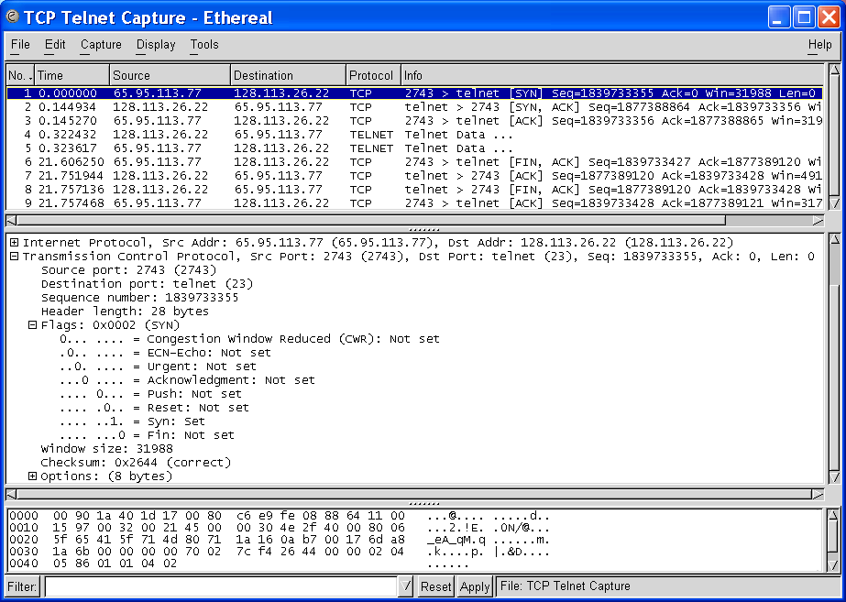
1st Handshake
Initial Seq. # from client to server
SYN bit set indicates request to establish connection from client to server

Slide 8
Transmitter
Receiver
Send Window
Receive Window
S_{last} + W_{a}-1
R_{last}
R_{last} + W_{R} – 1
...
...
...
bytes
transmitted
& ACKed
R_{next}
R_{new}
S_{last}
S_{recent}
S_{last} + W_{s} – 1
R_{last} highest-numbered byte not yet read by the application
R_{next} next expected byte
R_{new} highest numbered byte received correctly
R_{last}+W_{R}-1 highest-numbered byte that can be accommodated in receive buffer
S_{last} oldest unacknowledged byte
S_{recent} highest-numbered transmitted byte
S_{last}+W_{a}-1 highest-numbered byte that can be transmitted
S_{last}+W_{s}-1 highest-numbered byte that can be accepted from the application

Slide 9
TCP Data Exchange
Application Layers write bytes into buffers
TCP sender forms segments
When bytes exceed threshold or timer expires
Upon PUSH command from applications
Consecutive bytes from buffer inserted in payload
Sequence # & ACK # inserted in header
Checksum calculated and included in header
TCP receiver
Performs selective repeat ARQ functions
Writes error-free, in-sequence bytes to receive buffer

Slide 10
TCP Sequence #
The segment contains a sequence number that corresponds to the number of the first byte in the string that is being transmitted
Significantly differs from ARQs

Slide 11
TCP Flow Control
TCP receiver controls rate at which sender transmits to prevent buffer overflow
TCP receiver advertises a window size specifying number of bytes that can be accommodated by receiver
W_{A} = W_{R} – (R_{new –} R_{last})
TCP sender obliged to keep # outstanding bytes below W_{A}
(S_{recent} - S_{last}) ≤ W_{A}
Send Window
Receive Window
S_{last} + W_{A}-1
W_{A}
...
...
...
R_{last}
R_{new}
R_{last} + W_{R} – 1
S_{last}
S_{recent}
S_{last} + W_{s} – 1

Slide 12
TCP Retransmission Timeout
TCP retransmits a segment after timeout period
Timeout too short: excessive number of retransmissions
Timeout too long: recovery too slow
Timeout depends on RTT: time from when segment is sent to when ACK is received
Round trip time (RTT) in Internet is highly variable
Routes vary and can change in mid-connection
Traffic fluctuates

Slide 13
Adaptive RTT
TCP uses adaptive estimation of RTT
Measure RTT each time ACK received: τ_{n}
t_{RTT}(new) = α t_{RTT}(old) + (1 – α) τ_{n}
α = 7/8 typical

Slide 14
RTT Variability
Estimate variance σ² of RTT variation
Estimate for timeout:
t_{out} = t_{RTT} + k σ_{RTT}
If RTT highly variable, timeout increase accordingly
If RTT nearly constant, timeout close to RTT estimate
In practice, approximate estimation of deviation
d_{RTT}(new) = β d_{RTT}(old) + (1-β) | τ_{n} - t_{RTT} |
t_{out} = t_{RTT} + 4 d_{RTT}

Slide 15
Summary of the Lesson
TCP flow control is based on selective repeat ARQ, yet varies in several key aspects.

Slide 16
Unit 02.02.02 CS 5220: COMPUTER COMMUNICATIONS
Framing and PPP
XIAOBO ZHOU, Ph.D.
Professor, Department of Computer Science

Slide 17
Data Link Protocols
Packets
Data Links Services
Framing
Error control
Flow control
Multiplexing
Link Maintenance
Security: Authentication & Encryption
Examples
PPP
HDLC
Ethernet LAN
IEEE 802.11 (Wi Fi) LAN
Packets
Data link
layer
Data link
layer
A
Frames
Physical
layer
B
Physical
layer
Directly connected, wire-like
Losses & errors, but no out-of-sequence frames
Applications: Direct Links; LANs; Connections across WANs

Slide 18
Framing
transmitted
frames
received
frames
Mapping stream of physical layer bits into frames
Mapping frames into bit stream
Frame boundaries can be determined using:
Character Counts
Control Characters
Flags
CRC Checks
Framing
0111110101
0110110111

Slide 19
Character-Oriented Framing (Byte Stuffing)
Data to be sent
A
DLE
B
ETX
DLE
STX
E
After stuffing and framing
DLE
STX
A
DLE
DLE
B
ETX
DLE
DLE
STX
E
DLE
ETX
Frames consist of integer number of bytes
Special 8-bit patterns used as control characters
Byte used to carry non-printable characters in frame
DLE (data link escape) = 0x10
DLE STX (DLE ETX) used to indicate beginning (end) of frame
Insert extra DLE in front of occurrence of DLE STX (DLE ETX) in frame
All DLEs occur in pairs except at frame boundaries

Slide 20
Flag-based Framing & Bit Stuffing
HDLC frame
Flag
Address
Control
Information
FCS
Flag
any number of bits
Flag-based frame synchronization is for transferring an arbitrary number of bits within a frame

Slide 21
Bit Stuffing
Frame delineated by flag character
It uses bit stuffing to prevent occurrence of flag 01111110 (HEX 7E) inside the frame
Transmitter inserts extra 0 after each consecutive five 1s inside the frame
Receiver checks for five consecutive 1s
if next bit = 0, it is removed
if next two bits are 10, then flag is detected
If next two bits are 11, then frame has errors

Slide 22
Example: Bit stuffing & de-stuffing
(a)
Data to be sent
0110111111111100
After stuffing and framing
0111111001101111101111100001111110
(b)
Data received
0111111001101111101111100001111110
After destuffing and deframing
0110111111111100

Slide 23
PPP: Point-to-Point Protocol
Data link protocol for point-to-point lines in Internet
Router-router; dial-up to router
1. Provides Framing and Error Detection
Character-oriented HDLC-like frame structure
2. Link Control Protocol
Bringing up, testing, bringing down lines; negotiating options
Authentication: key capability in ISP access
3. A family of Network Control Protocols specific to different network layer protocols
IP, OSI network layer, IPX (Novell), Appletalk

Slide 24
PPP Frame
Flag
Address
Control
Protocol
Information
CRC
Flag
01111110
1111111
00000011
01111110
integer # of bytes
All stations are to
accept the frame
Unnumbered frame
Specifies what kind of packet is contained in the payload, e.g., LCP, NCP, IP, OSI CLNP, IPX
PPP uses similar frame structure as HDLC, except
Protocol type field
Payload contains an integer number of bytes
PPP uses the same flag, but uses byte stuffing
Problems with PPP byte stuffing
Size of frame varies unpredictably due to byte insertion
Malicious users can inflate bandwidth by inserting 7D & 7E

Slide 25
Byte-Stuffing in PPP
PPP is character-oriented version of HDLC
Flag is 0x7E (01111110)
Control escape 0x7D (01111101)
Any occurrence of flag or control escape inside of frame is replaced with 0x7D followed by original octet XORed with 0x20 (00100000)
Data to be sent
41
7D
42
7E
50
70
46
After stuffing and framing
7E
41
7D
5D
42
7D
5E
50
70
46
7E

Slide 26
PPP Applications
PPP used in many point-to-point applications
Telephone Modem Links 30 kbps
Packet over SONET 600 Mbps to 10 Gbps
IP→PPP→SONET
PPP is also used over shared links such as Ethernet to provide LCP, NCP, and authentication features
PPP over Ethernet (RFC 2516)
Used over DSL

Slide 27
PPP Authentication
Password Authentication Protocol
Initiator must send ID & password
Authenticator replies with authentication success/fail
After several attempts, LCP closes link
Transmitted unencrypted, susceptible to eavesdropping
Challenge-Handshake Authentication Protocol (CHAP)
Initiator & authenticator share a secret key
Authenticator sends a challenge (random # & ID)
Initiator computes cryptographic checksum of random # & ID using the shared secret key
Authenticator calculates cryptocgraphic checksum & compares to response
Authenticator can reissue challenge during session
Notes:
LCP = link control protocol

Slide 28
Summary
Bit stuffing and byte stuffing are used for framing
PPP uses byte stuffing
CHAP is a security protocol

Slide 29
Unit 02.02.03 CS 5220: COMPUTER COMMUNICATIONS
HDLC, Multiplexing
XIAOBO ZHOU, Ph.D.
Professor, Department of Computer Science

Slide 30
High-Level Data Link Control (HDLC)
Bit-oriented data link control
Derived from IBM Synchronous Data Link Control (SDLC)
Related to Link Access Procedure Balanced (LAPB)
LAPD in ISDN
LAPM in cellular telephone signaling

Slide 31
Network
layer
NLPDU
Network
layer
“Packet”
DLSDU
DLSAP
DLSAP
DLSDU
Data link
layer
DLPDU
Data link
layer
“Frame”
Physical
layer
Physical
layer

Slide 32
HDLC Data Transfer Modes
Normal Response Mode (NRM)
Used in polling multi-drop lines
Commands
Primary
Responses
Secondary
Secondary
Secondary
Asynchronous Balanced Mode (ABM)
Used in full-duplex point-to-point links
Primary
Commands
Responses
Secondary
Secondary
Responses
Commands
Primary

Slide 33
HDLC Frame Format
Flag
Address
Control
Information
FCS
Flag
Control field gives HDLC its functionality
Codes in fields have specific meanings and uses
Flag: delineate frame boundaries
Address: identify secondary station (1 or more octets)
In ABM mode, a station can act as primary or secondary so address changes accordingly
Control: purpose & functions of frame (1 or 2 octets)
Information: contains user data; length not standardized, but implementations impose maximum
Frame Check Sequence: 16- or 32-bit CRC

Slide 34
Control Field Format
Information Frame
1
2-4
5
6-8
0
N(S)
P/F
N(R)
Supervisory Frame
1
0
S
S
P/F
N(R)
Unnumbered Frame
1
1
M
M
P/F
M
M
M

Slide 35
Error Detection & Loss Recovery
Frames lost due to loss-of-synch or receiver buffer overflow
Frames may undergo errors in transmission
CRCs detect errors and such frames treated as lost
Recovery through ACKs, timeouts & retransmission
Sequence numbering to identify out-of-sequence & duplicate frames
HDLC provides for options that implement several ARQ methods

Slide 36
Statistical Multiplexing
Multiplexing concentrates bursty traffic onto a shared line
Greater efficiency and lower cost
Header Data payload
A
B
Buffer
Output line
C
Input lines

Slide 37
Tradeoff Delay for Efficiency
(a)
Dedicated lines
A₁
A₂
B₁
B₂
C₁
C₂
(b)
Shared lines
A₁
C₁
B₁
A₂
B₂
C₂
Dedicated lines involve not waiting for other users, but lines are used inefficiently when user traffic is bursty
Shared lines concentrate packets into shared line; packets buffered (delayed) when line is not immediately available

Slide 38
Multiplexers inherent in Packet Switches
1
1
2
2
●
●
●
●
●
●
N
N
Packets/frames forwarded to buffer (queue) prior to transmission from switch
Multiplexing occurs in these buffers; FIFIO vs priority scheduling

Slide 39
Delay and Utilization Tradeoff
Buffering introduces packet delay
Buffer overflow introduces packet loss
End-to-end protocols deals with loss

Slide 40
Multiplexer Modeling
Input lines
A
Output line
Buffer
B
C
Arrivals: What is the packet inter-arrival pattern?
Service Time: How long are the packets?
Service Discipline: What is order of transmission?
Buffer Discipline: If buffer is full, which packet is dropped?
Performance Measures: Delay Distribution; Packet Loss Probability; Line Utilization

Slide 41
Delay = Waiting + Service Times
P1
P2
P3
P4
P5
Packet completes
transmission
Service
time
Packet begins
transmission
Waiting
time
Packet arrives
at queue
P1
P2
P3
P4
P5

Slide 42
Delay = Waiting + Service Times
Packets arrive and wait for service
Waiting Time: from arrival instant to beginning of service
Service Time: time to transmit packet
Delay: total time in system = waiting time + service time

Slide 43
Fluctuations in Packets in the System
(a)
Dedicated lines
A₁
A₂
B₁
B₂
C₁
C₂
(b)
Shared line
A₁
C₁
B₁
A₂
B₂
C₂
(c)
N(t)
Number of packets in the system

Slide 44
Poisson Arrivals & Queuing
Average Arrival Rate: λ packets per second
Arrivals are equally-likely to occur at any point in time
Time between consecutive arrivals is an exponential random variable with mean 1/ λ
Number of arrivals in interval of time t is a Poisson random variable with mean λt

Slide 45
Summary
Multiplexing makes good tradeoff of delay and utilization
Queueing involves sophisticated modeling and analysis

